Slide 1
Computer Abstraction
Chapter 1

Slide 2
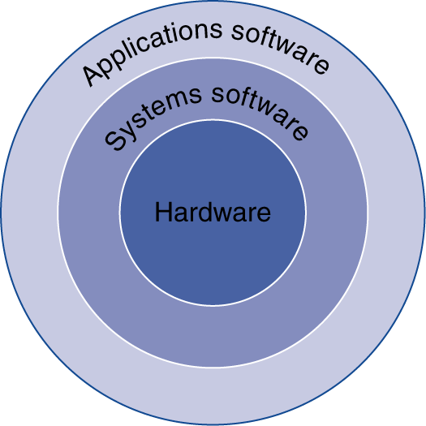
Below Your Program
Application software
Written in high-level language
System software
Compiler: translates HLL code to machine code
Operating System: service code
Handling input/output
Managing memory and storage
Scheduling tasks & sharing resources
Hardware
Processor, memory, I/O controllers
§1.2 Below Your Program

Slide 3
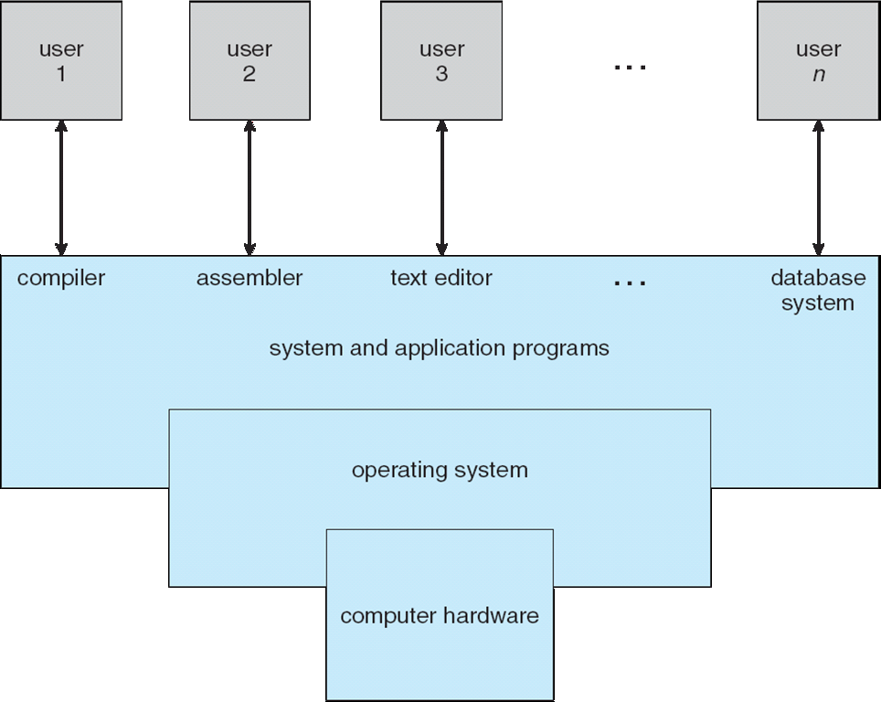
Another View
From Operating Systems Concepts w Java 8e
Silbershatz and Gagne

Slide 4
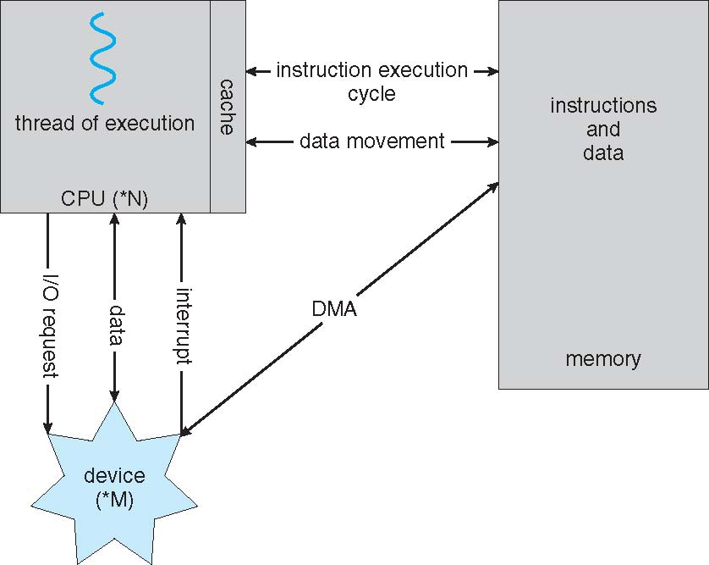
Hardware Abstraction
registers
From Operating Systems Concepts w Java 8e
Silbershatz and Gagne

Slide 5
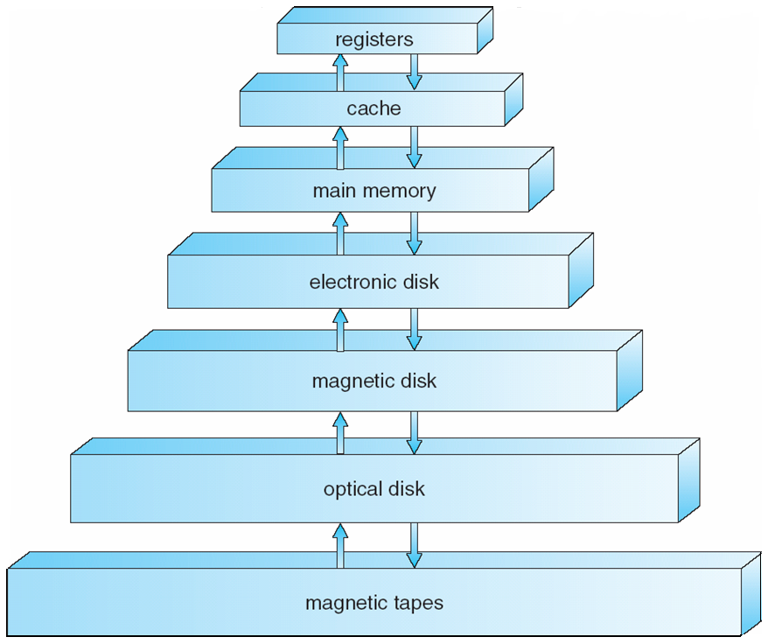
Storage Device Hierarchy
From Operating Systems Concepts w Java 8e
Silbershatz and Gagne

Slide 6
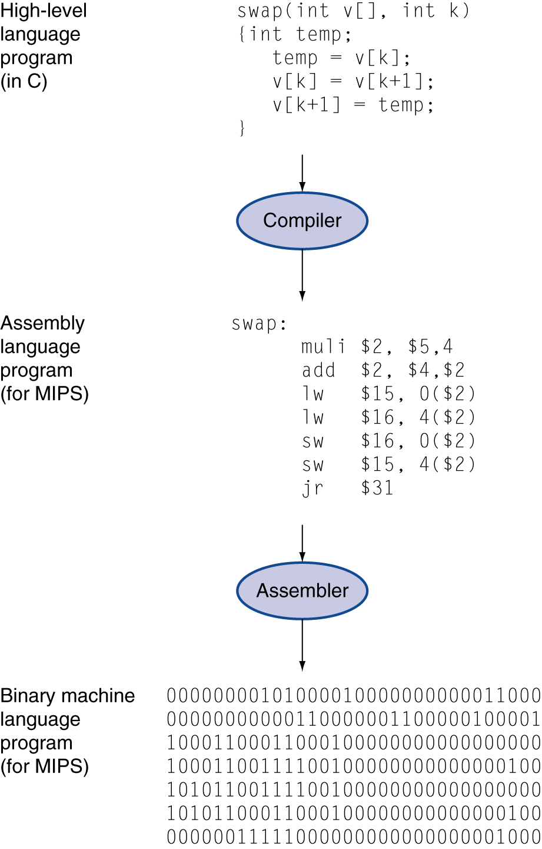
Levels of Program Code
High-level language
Level of abstraction closer to problem domain
Provides for productivity and portability
Assembly language
Textual representation of instructions
Hardware representation
Binary digits (bits)
Encoded instructions and data

Slide 7
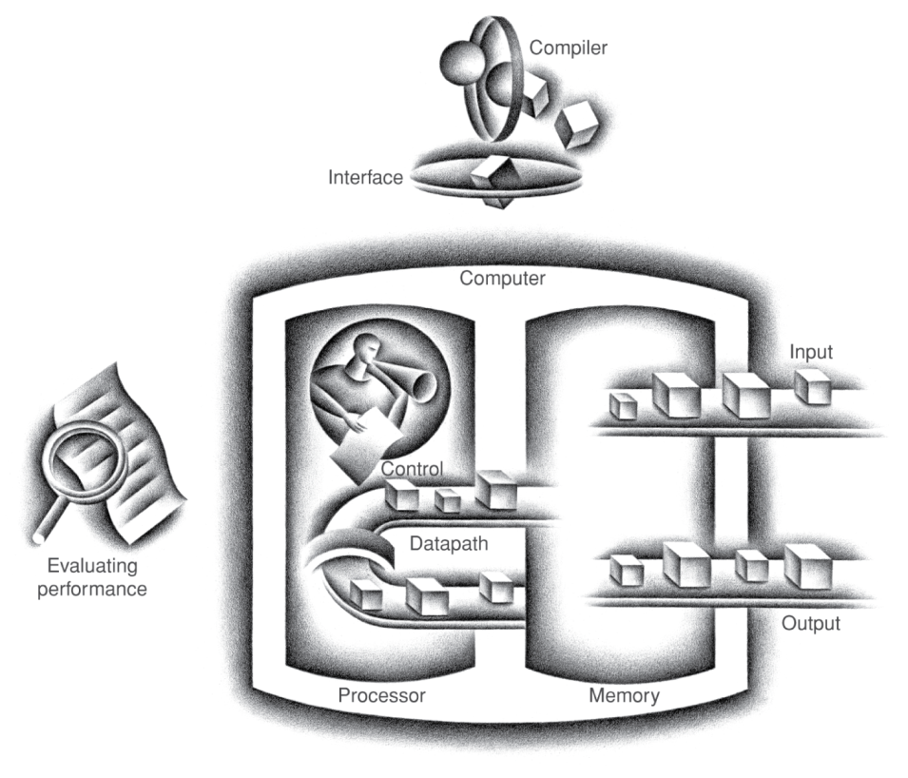
Components of a Computer
Same components for all kinds of computer
Desktop, server, embedded
Input/output includes
User-interface devices
Display, keyboard, mouse
Storage devices
Hard disk, CD/DVD, flash
Network adapters
For communicating with other computers
§1.3 Under the Covers
The BIG Picture

